Slide 1

Logistic Regression
A Classification Technique

Slide 2
Regression Vs Classification
REGRESSION
Response variable 'Y' is quantitative(Continous)
Example:
(i) Predicting price of house
(ii) Sales prediction
(iii) predicting wages, etc.
CLASSIFICATION
Response variable 'Y' is qualitative/Categorical(Descrete)
Example:
(i) Predicting Email is spam or not
(ii) Gender prediction
(iii) loan approval, etc

Slide 3
Why Regression not fit for classification Task
Say that an unknown patient’s illness in the Emergency Room has been narrowed down to three possible causes:
1) Drug Overdose
2) Siezure
3) Stroke
Now we need to know which of these causes is most likely. So, our Y here is qualitative as we need the result to be either Y = {Drug Overdose (1) or Seizure (2) or Stroke(3)}
If we were to plug this into the LinearRegression() model, the first problem is that our output values would not be in the range 1-3, we would get values more extreme. Therefore our results, would not have any meaningful interpretation.
Consider the problem of predicting default rates of customers given their account balance. This is a binary problem Y= {Default|Not-default}

Slide 4
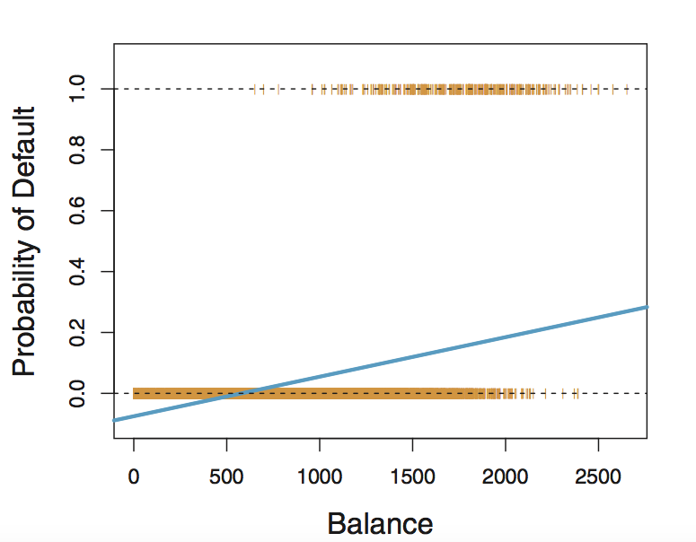
Linear Regression Modelling Probability

Slide 5
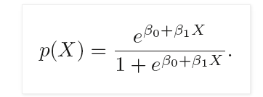
Introducing Logistic Regression
So, one thing we know is that we need to fit such a line that will be in the interval {0,1}.
What the logistic regression does is setup the problem like this:
Y = {0:Not-default X = {B1 :Income
1: Default } B2: Balance}
Then the task is to model the probability of default so we have
P(Default = Yes|Income) and P(Default= Yes|Balance)=P(X)
And we know P(X)=B0+BX

Slide 6
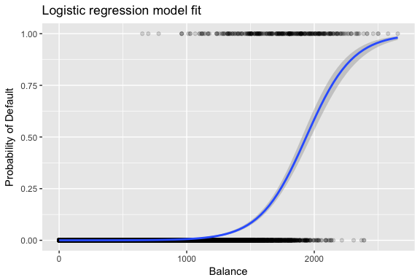
Introducing Logistic Regression
That particular specification produces a Sigmoid or S-shaped line.

Slide 7

Introducing Logistic Regression
To make our equation more interpretable, we can divide both sides of the logistic equation by 1-P(X) and then take the natural log. This gives,
Now our output values are probabilities in the interval of {0,1}
So if we create a probability threshold where P(X) > 0.5 = Default and P(X) < 0.5 = Not-default. Now, our results are interpretable!
What about interpreting our beta’s ? Well since our line is non-linear the interpretation is not straightforward but fundamentally still, an a positive coefficient for Income implies that an income increase the probability of default increases as well.

Slide 8
Evaluating Logistic Regression
How do we assess the predictions of Logistic Regression? How would you evaluate any classification problem?
Its quite simple, how many predictions of something belonging to a particular class were correct/incorrect?
So here is one approach. Lets take a binary response variable example.
In our test dataset of 100 observations, there are 80 (0’s) and 20 (1’s). So, if model got 70 of the predictions correct on x_test, we have an overall accuracy of 70%.
But it got 60/80 of the (0’s) correct but only 10/20 (1’s). Does our overall accuracy measure still do justice?
To tackle this, we use the two concepts of precision and recall.

Slide 9
Evaluating Logistic Regression
So with those formulae in mind, we can interpret precision as a measure of result relevancy, while recall is a measure of how many truly relevant results are returned.
Ideally, we want both our precision and recall to be as low as possible, however there is a tradeoff. The tradeoff is easy to observe by way of a confusion matrix.

Slide 10
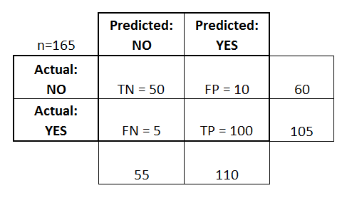
Confusion Matrix

Slide 11
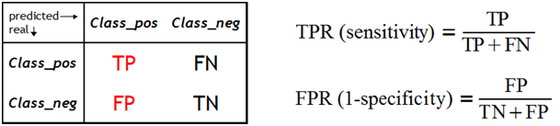
AUROC
AUCROC stands for Area Under the Receiver Operating Characteristic curve. It measures the performance of binary classifier.
We can extend the Precision and Recall concepts to get;
Notes:
We can loosely interpret TPR as how right we were and FPR as proportion of negative data points that are mistakenly considered as positive, with respect to all negative data points. In other words, the higher FPR, the more negative data points we will missclassified.

Slide 12
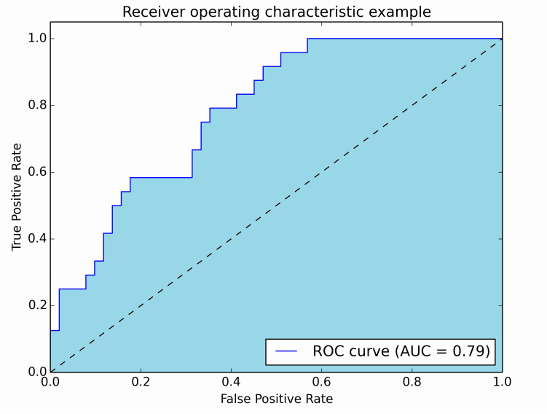
If we plot TPR vs FPR

Slide 13
Evaluating: Bias-Variance Tradeoff
How do we assess the predictions of Logistic Regression?
Lets revisit the Linear Regression Model evaluation. Since our regression is a sample estimate, even our MSE was a sample estimate.
That is MSE = E(yactual-yˆ)2 , where E(yactual-yˆ)2 is our expected or most likely MSE.
This E(yactual-yˆ)2 is composed of three parts = Var(yˆ) + Bias(yˆ)2 + Var(𝞊). The first two terms are reducible and the last is irreducible.
Therefore, MSE is minimized by reducing the irreducible components.
Var(yˆ) is the amount of variance in our predicted (yˆ) using different datasets since each unique set may result in a different (yˆ). If Var(yˆ) is high, even small changes in our data will lead to different yˆ’s .
Bias(yˆ)2 refers to the amount by which our prediction is different from our true value, our accuracy.
So variance measures our model’s consistency and Bias the accuracy.

Slide 14
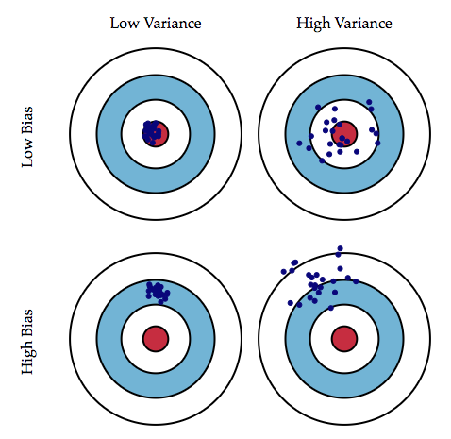
A Visual Representation

Slide 15
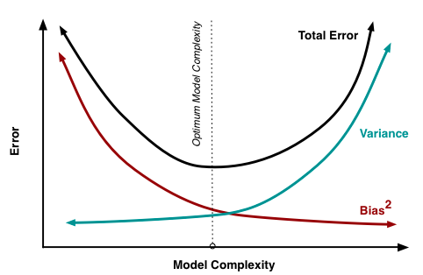
Graphical Representation

Slide 16
Remember!
Logistic regression does not predict a class in itself, but the probability that something belong to a particular class.
The probability threshold is not always 0.5. This is often a business decision. For example, a Bank may want to be very sure of default and may have a threshold of 0.2. So only if a customer is less than 20% likely to default is a loan extended.
Logistic regression does not do too well for multi-class classification. While it is possible, the results are not very stable.

Slide 17
Calculating Cost Function

Slide 18
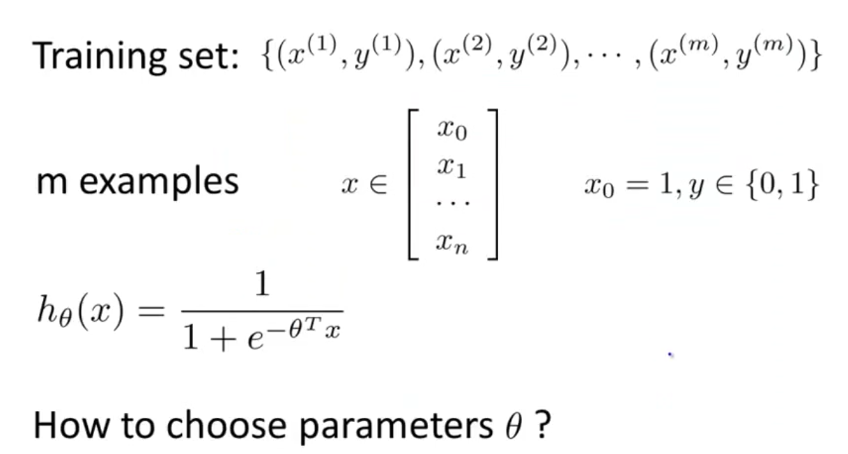

Slide 19
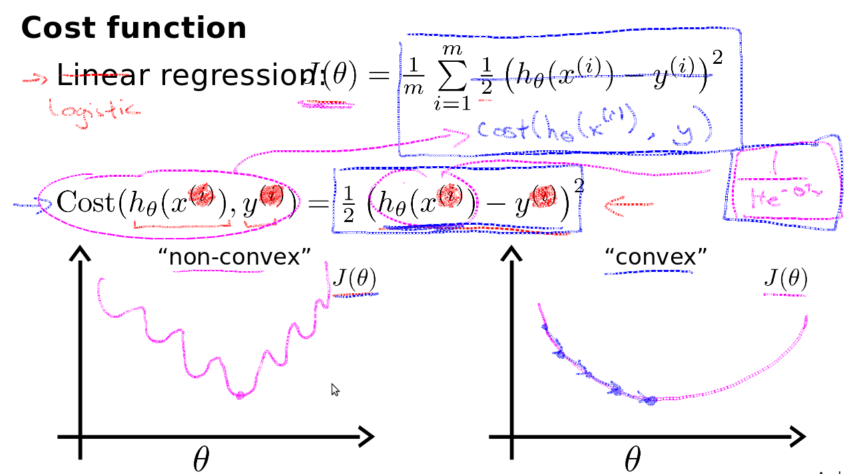

Slide 20
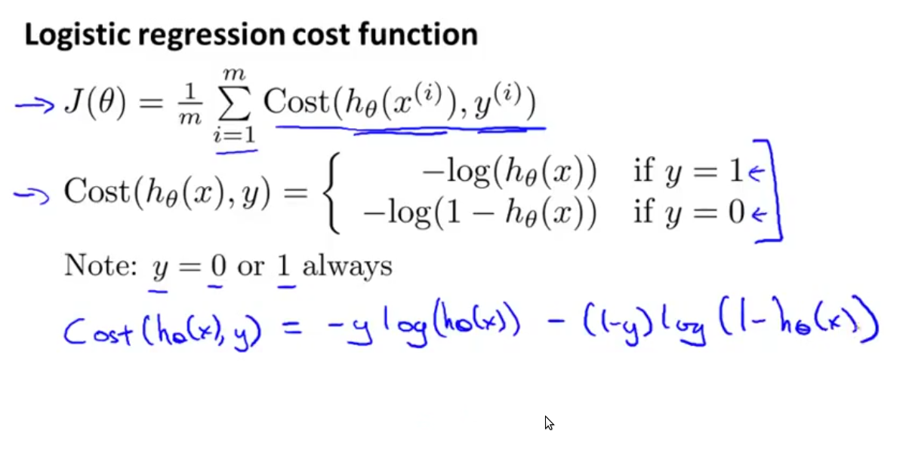

Slide 21
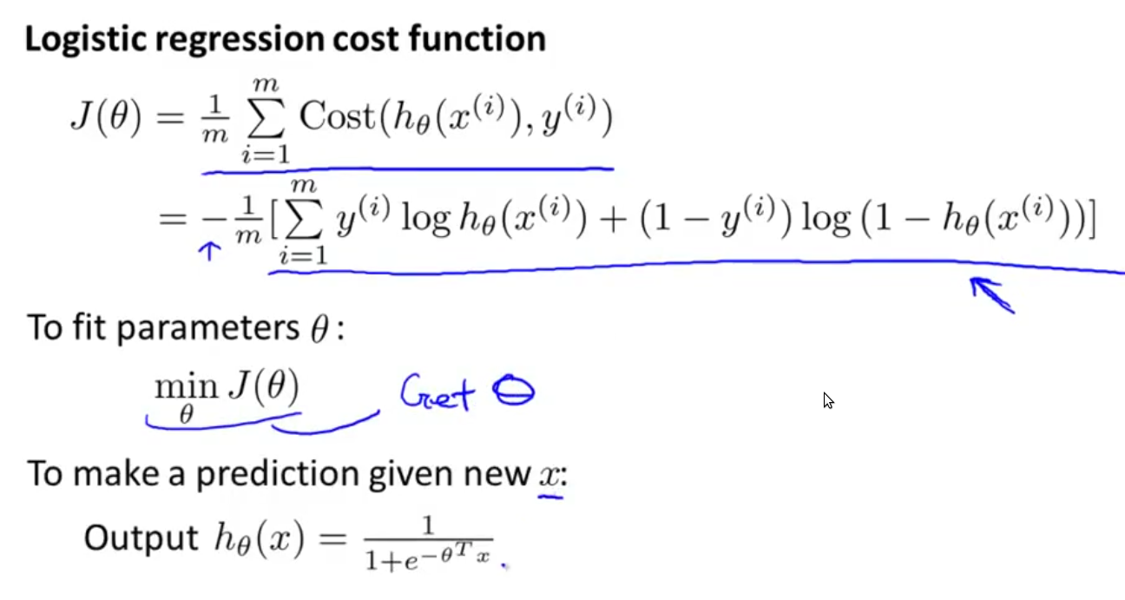

Slide 22
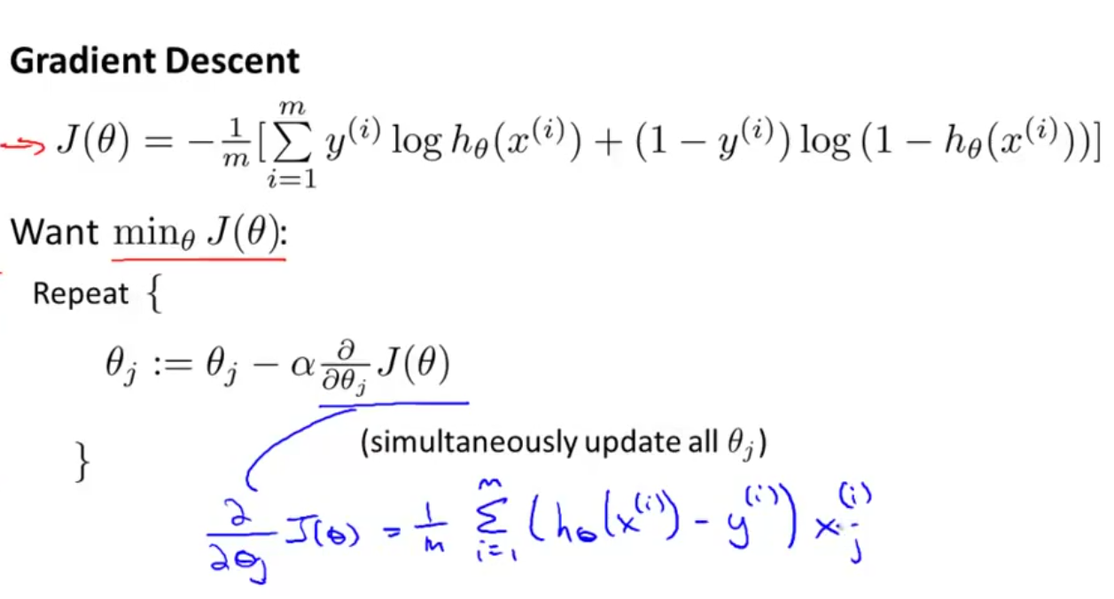

Slide 23
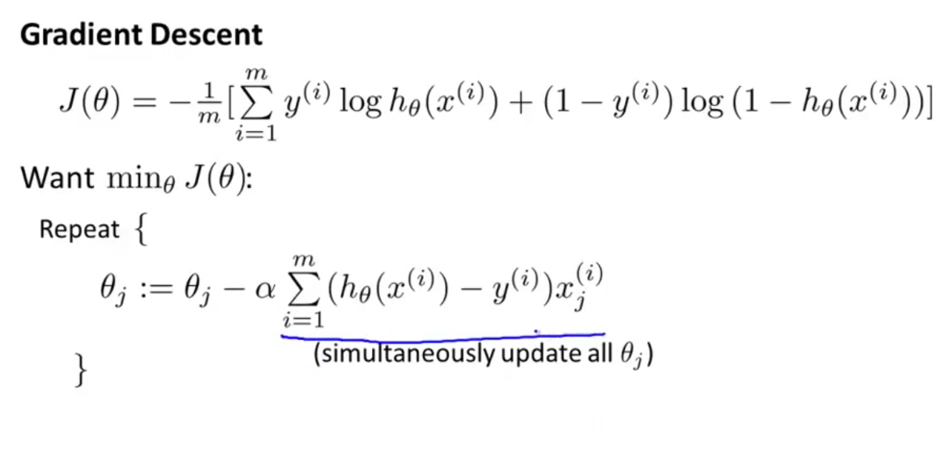

Slide 24
